Slide 1

Change Feed

Slide 2
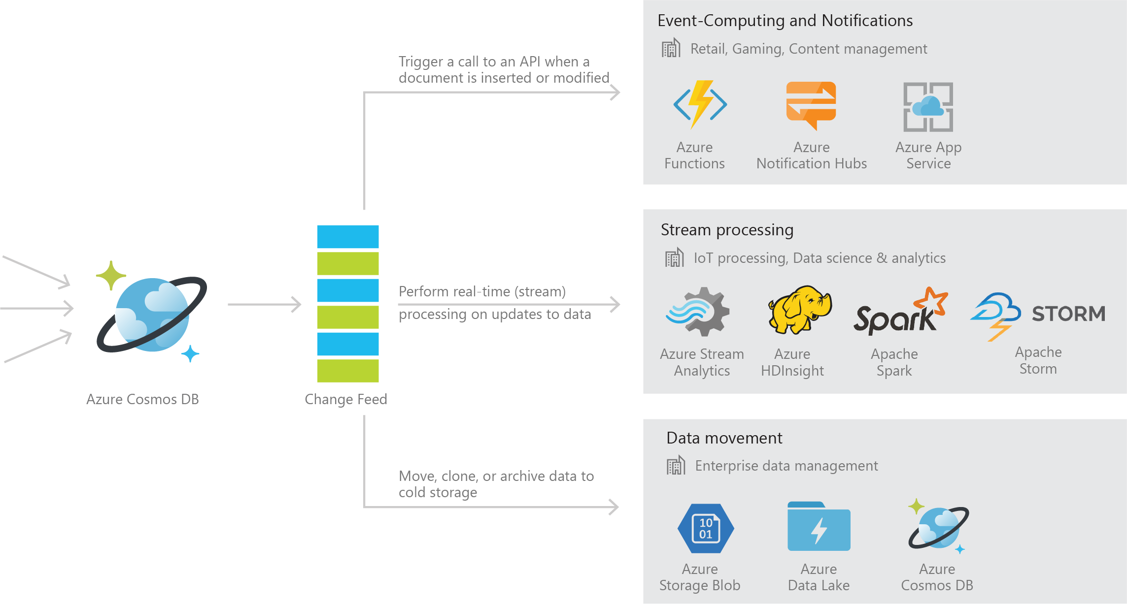
Azure Cosmos DB Change Feed
Persistent log of records within an Azure Cosmos DB container in the order in which they were modified

Slide 3
Common Scenarios

Slide 4


Event Sourcing for Microservices
Trigger Action From Change Feed
Persistent Event Store
Microservice
#1
Microservice #2
New Event
…
Microservice #N

Slide 5
Materializing Views
Application
Cosmos DB
Materialized View
Subscription | User | Create Date | …
123abc | Ben6 | 6/17/17
456efg | Ben6 | 3/14/17
789hij | Jen4 | 8/1/16
012klm | Joe3 | 3/4/17
User | Total Subscriptions
Ben6 | 2
Jen4 | 1
Joe3 | 1

Slide 6


Replicating Data
Secondary Datastore (e.g. archive)
Replicate Records
CRUD Data

Slide 7
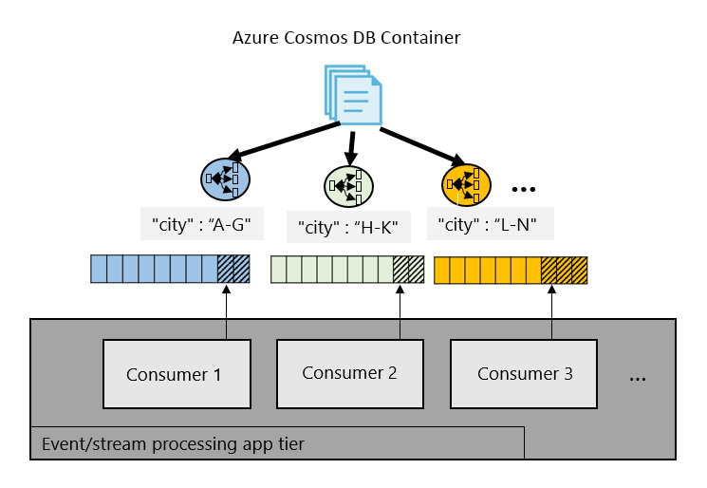
Working with Change Feed

Slide 8
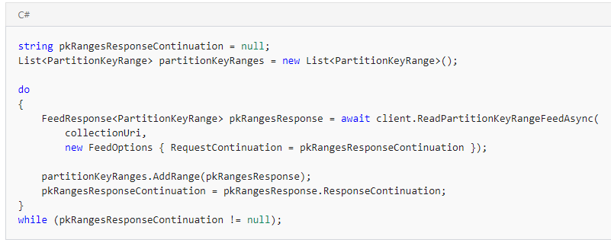
Working with Change Feed
Step 1: Retrieve a list of the partition key ranges

Slide 9
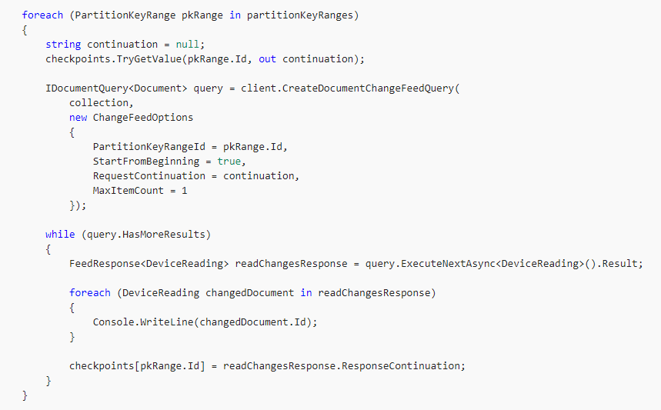
Working with Change Feed
Step 2: Consume the Change Feed on each PartitionKeyRange

Slide 10
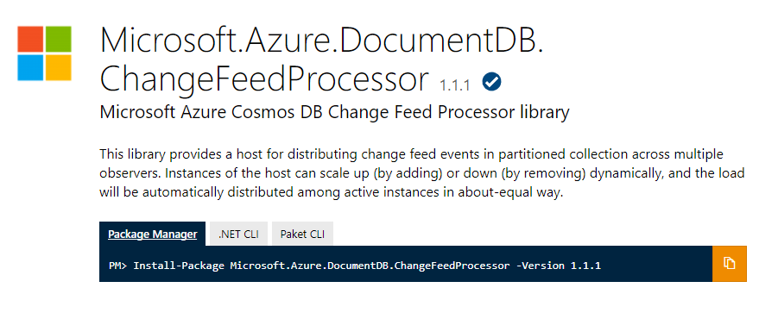
Change Feed Processor Library

Slide 11
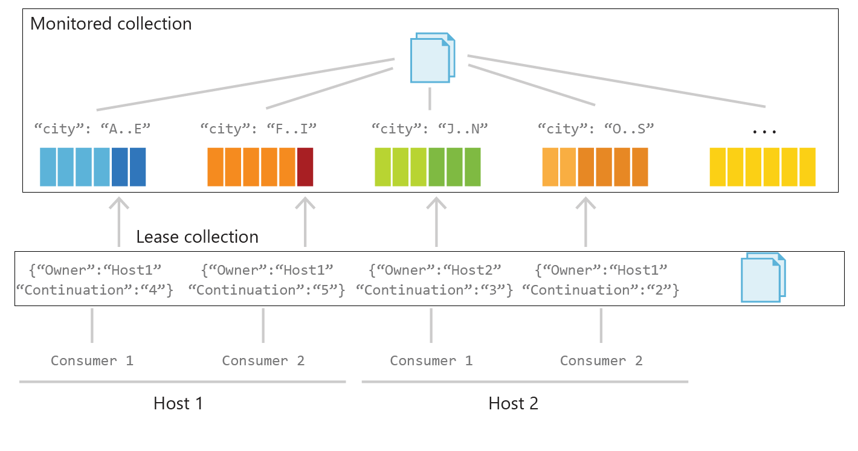
Behind the Scenes

Slide 12
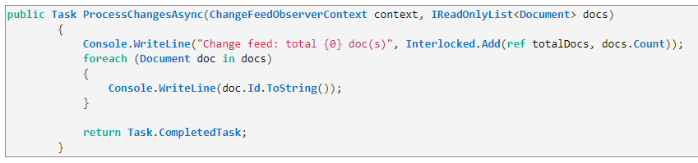
Working with Change Feed Processor Library
Step 1: Implement ProcessChangesAsync() on IChangeFeedObserver

Slide 13
Working with Change Feed Processor Library
Step 2: Register the IChangeFeedObserver with to a ChangeFeedEventHost

